Slide 1

Project 3 Group 1
Evgeniia Kozodeeva. Jiahuib Du(Mary)
Mark Krishnan. Sher WANG

Slide 2
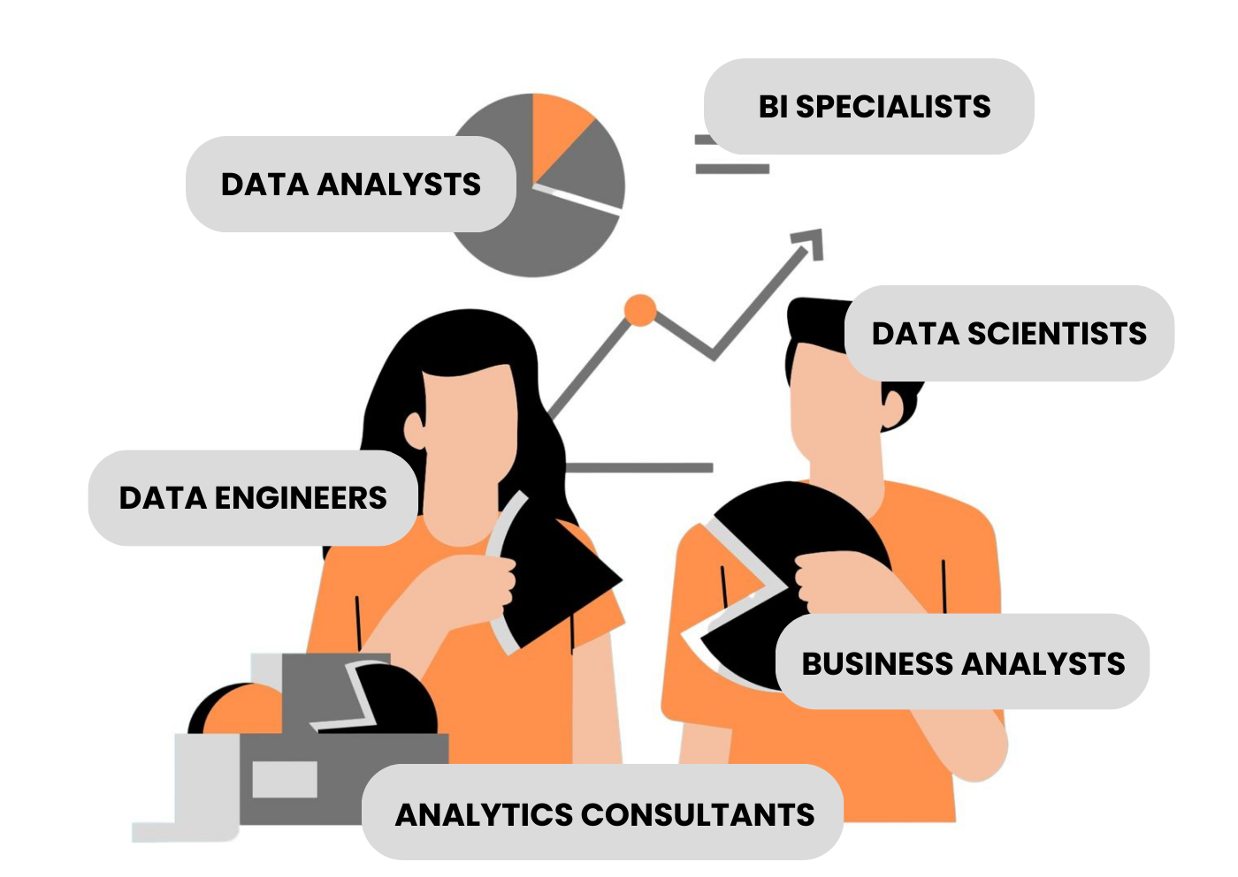
Finding a job is confusing
EVERY EMPLOYER USES DIFFERENT TERMS AND WORDS IN JOB LISTINGS.
WOULDN’T IT BE EASIER TO BE ABLE TO SEE WHAT ALL THE EMPLOYERS ARE ASKING FOR IN THE EMPLOYMENT FIELD?
AND IN WHAT REGIONS THEY ARE HIRING?
WE HAVE CREATED AN APP TO SHOW THE USER A VISUAL SUMMARY OF WHAT TERMS/BUZZWORDS COMPANIES USE FOR ADS!

Slide 3
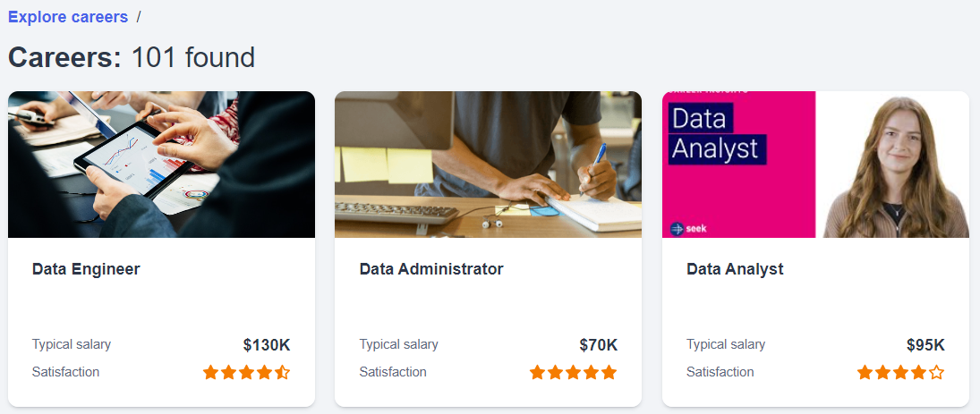
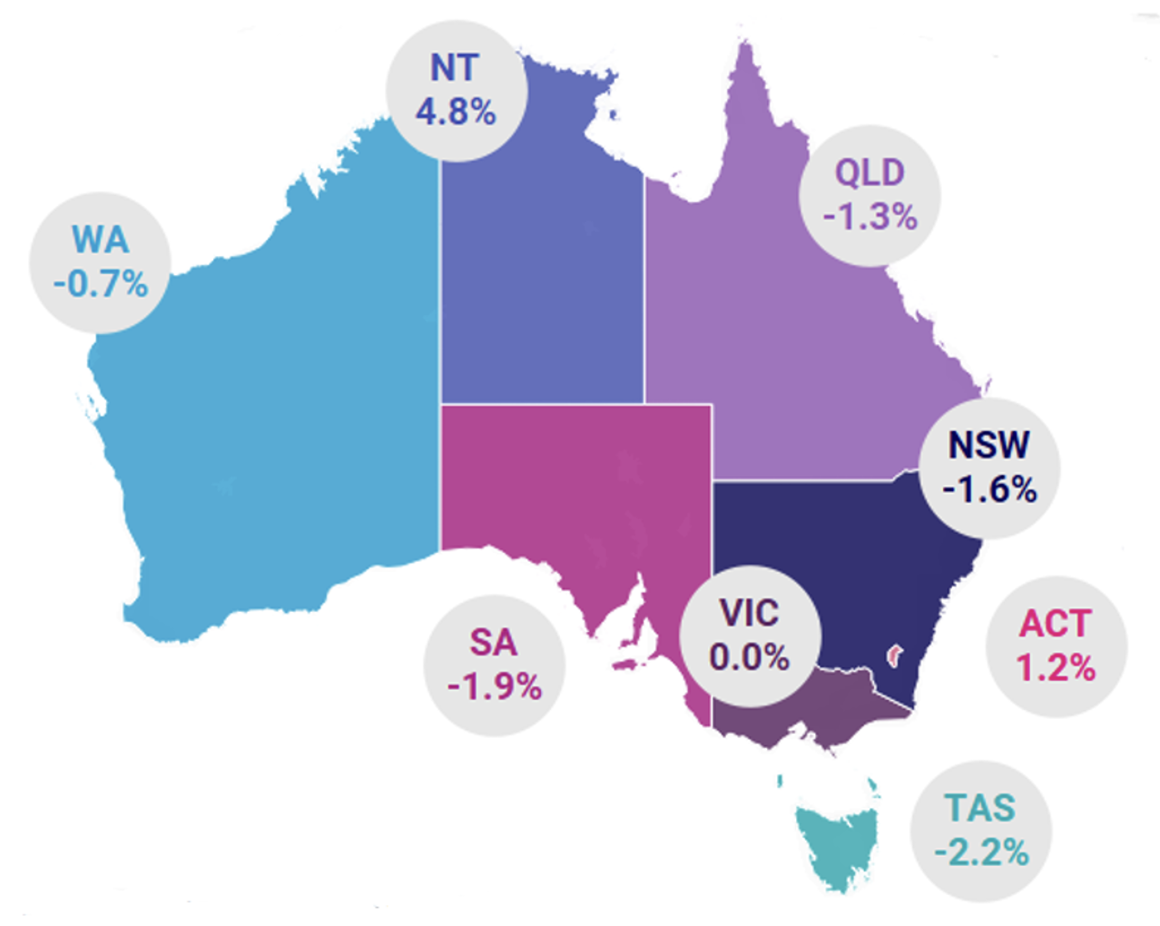
Job Market Insights: A Web Scraper for Data Analyst and Data Engineer Job Ads

Slide 4
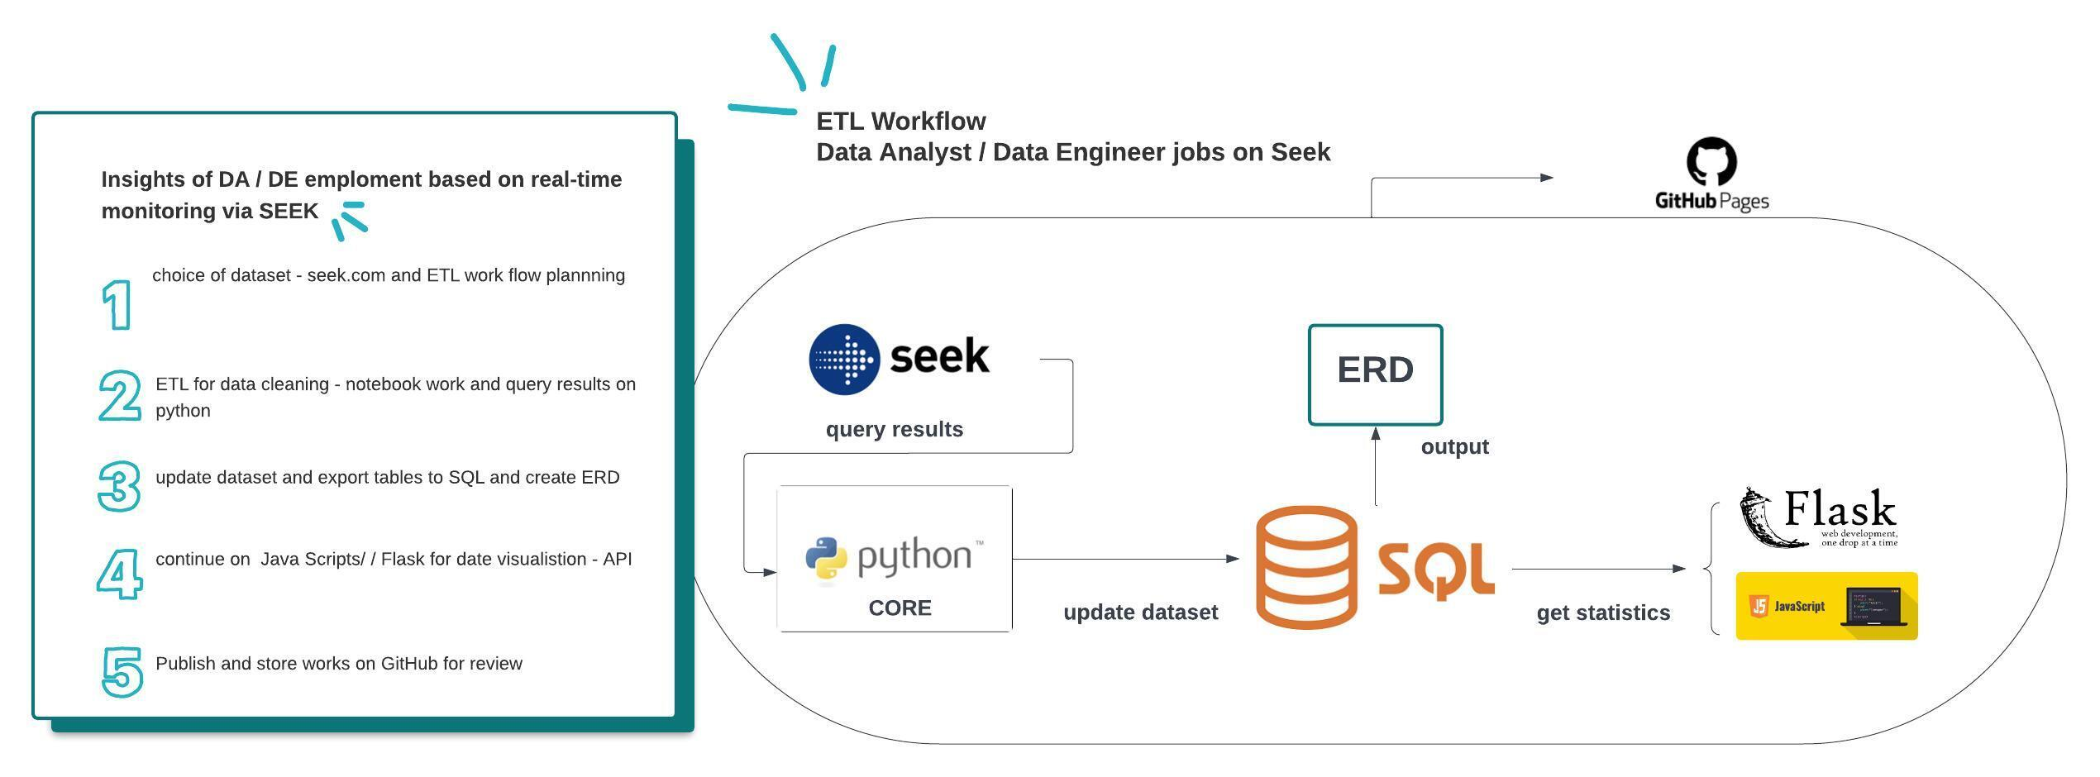
Etl workflow

Slide 5
LIBRARY
import requests
import regex
Import BeautifulSoup
from sqlalchemy import create_engine / from sqlalchemy import inspect / import psycopg2
from wordcloud import WordCloud

Slide 6
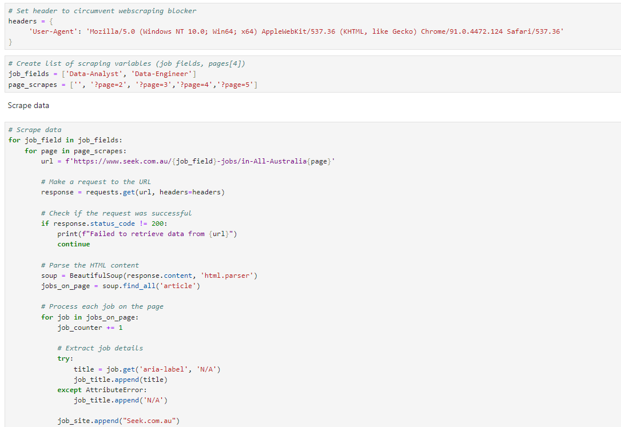
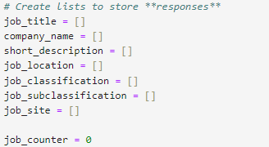
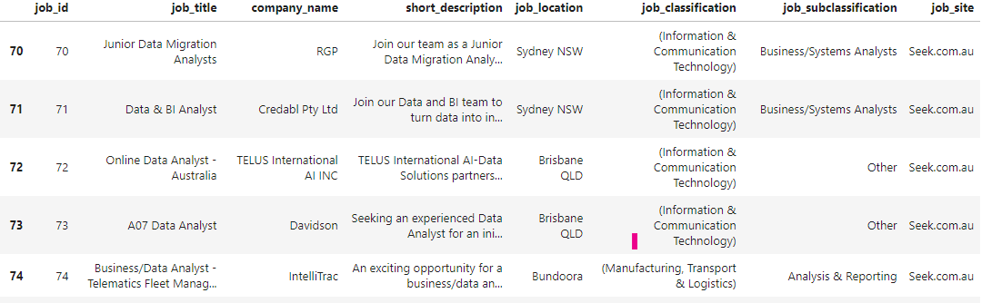
Jobs Scraped from seek using BEAUTIFUL SOUP Webscraping blocker avoided by adding header to request.
Seek Webscraping

Slide 7
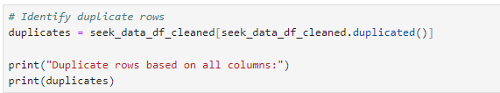
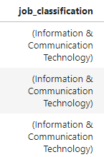
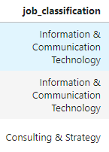
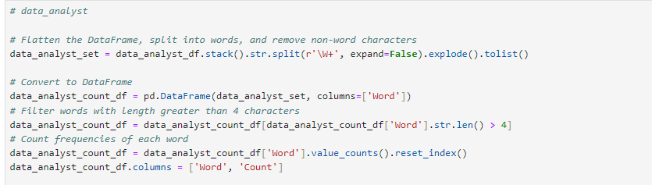
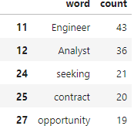
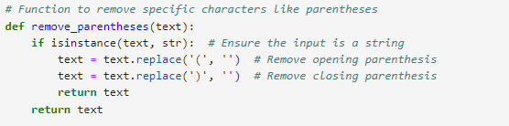
Transformimg: 1. Duplicate
2. Remove Function
3. Split and filters

Slide 8
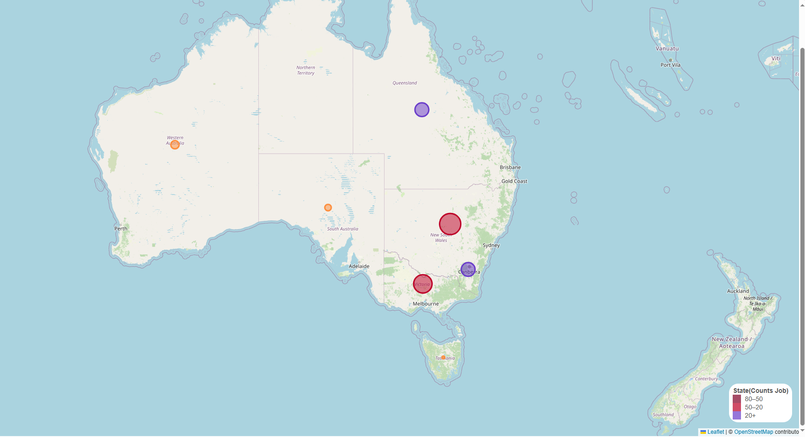
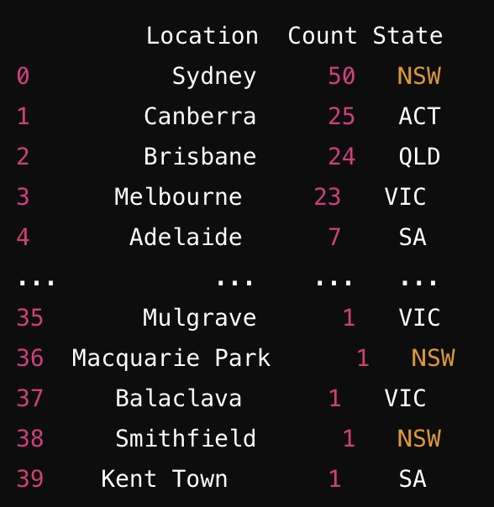
JOB BY LOCATION
Total Job Occurrences by State Count
ACT 30
NSW 77
QLD 37
SA 7
TAS 1
VIC 51
WA 13

Slide 9
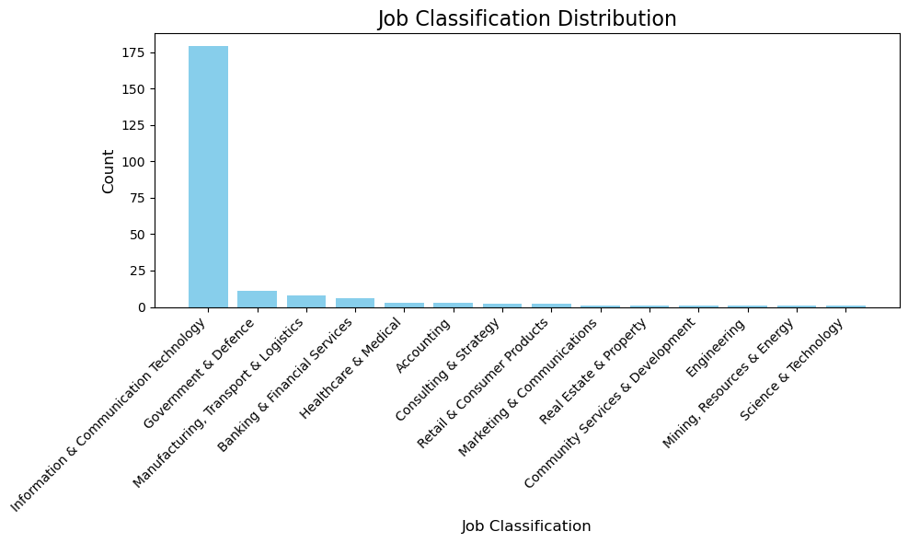
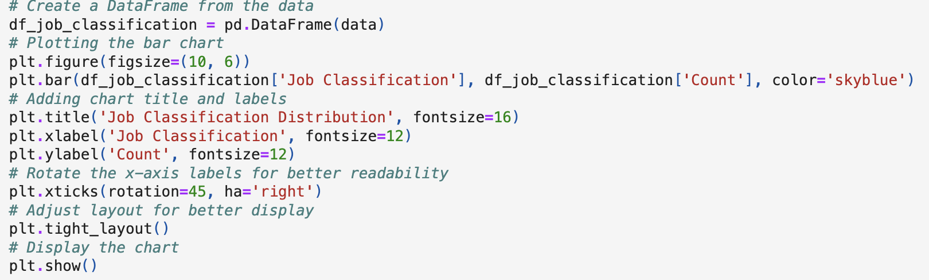
Job Classification
Information & Communication Technology 179
Government & Defence 11
Manufacturing, Transport & Logistics 8
Banking & Financial Services 6
Healthcare & Medical 3
Accounting 3
Consulting & Strategy 2
Retail & Consumer Products 2
Marketing & Communications 1
Real Estate & Property 1
Community Services & Development 1
Engineering 1
Mining, Resources & Energy 1
Science & Technology 1

Slide 10
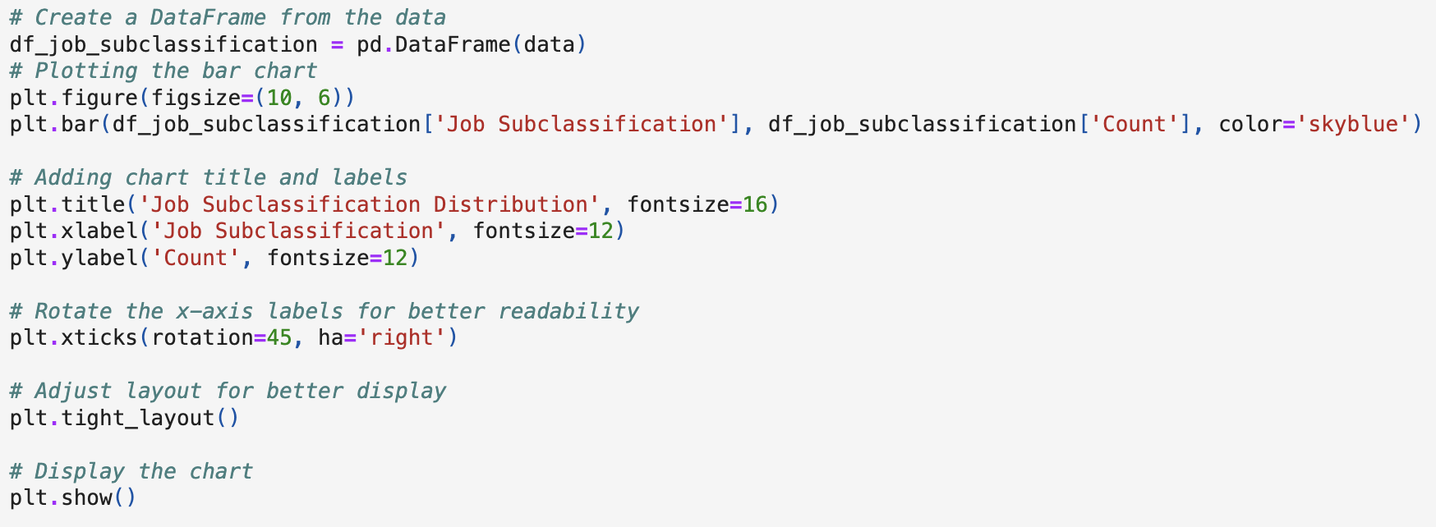
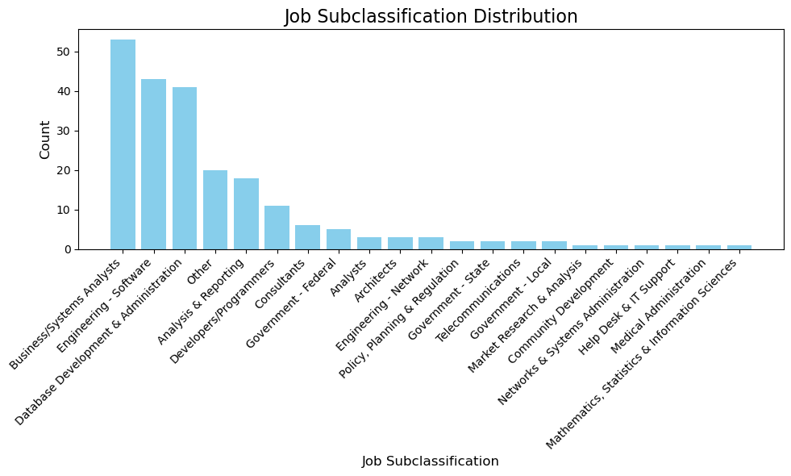
job subclassification
Business/Systems Analysts 53 Engineering - Software 43 Database Development & Administration 41
Other 20
Analysis & Reporting 18 Developers/Programmers 11 Consultants 6
Government - Federal 5 Analysts 3
Architects 3
Engineering - Network 3
Policy, Planning & Regulation 2 Government - State 2 Telecommunications 2 Government - Local 2

Slide 11
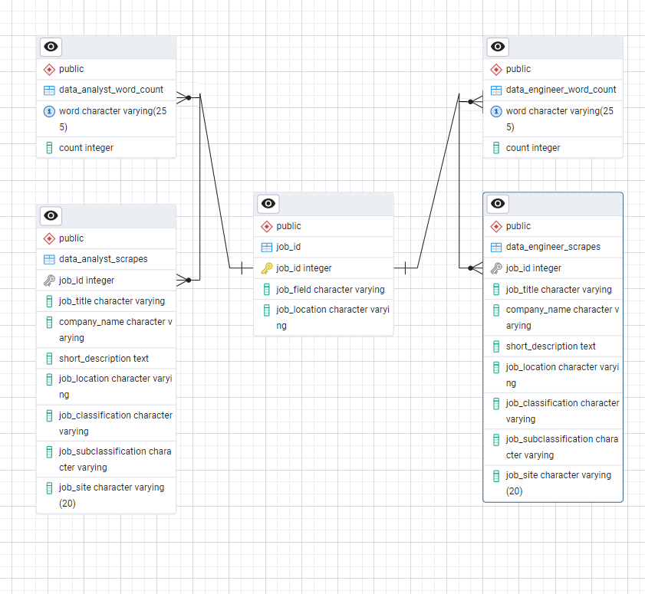

ERD

Slide 12
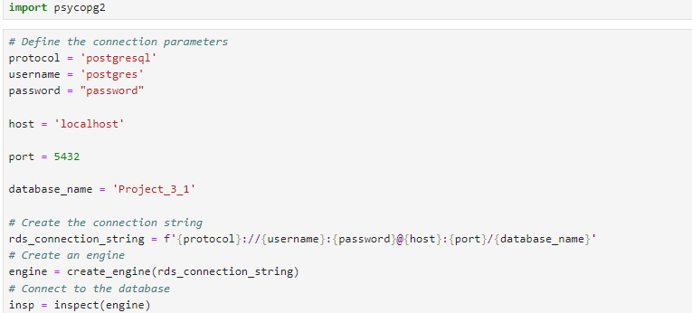
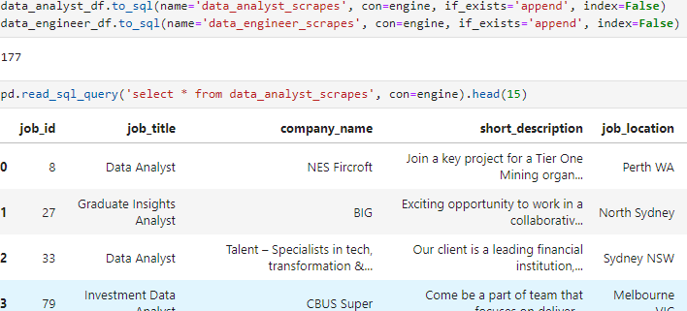
Connect to postgres and load data to db

Slide 13
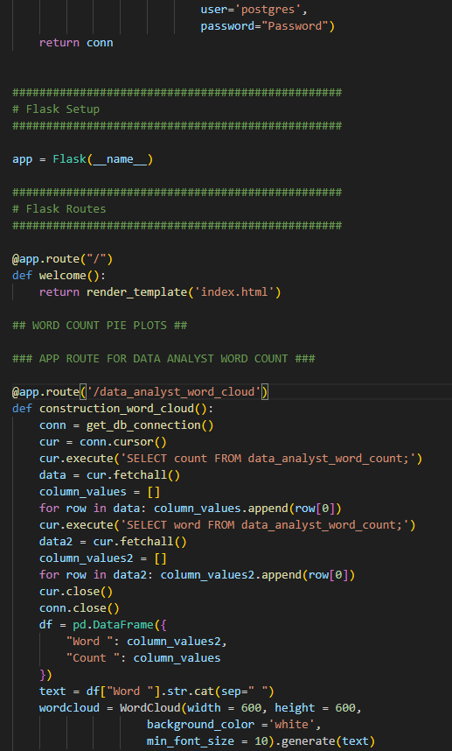
FLASK
Flask Routes:
Set up routes to render different
Word Cloud visualizations.
HTML Templates:
Create templates to render
the images and handle
the display logic.

Slide 14

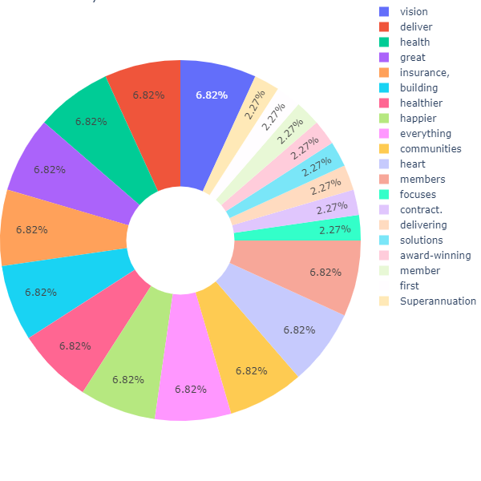
GET INSPIRED WORDCLOUD
BUZZWORDS
VISION, DELIVER, HEALTH, GREAT, INSURANCE, BUILDING
DATA ANALYST

Slide 15
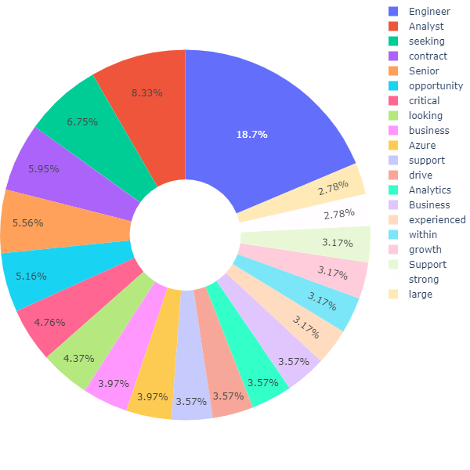
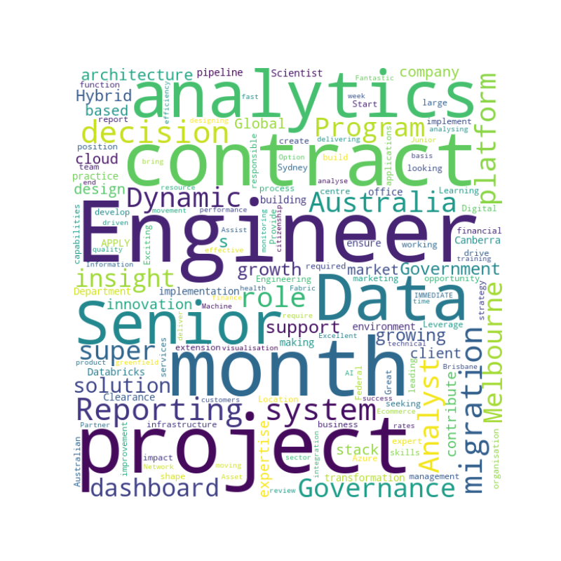
RESUME BOOSTER – KEYWORDS
BUZZWORDS
ENGINEER, ANALYST, SEEKING CONTRACT,SENIOR
DATA ENGINEER

Slide 16
Key Outcomes
Efficient Data Management: The project effectively utilizes data structures like dictionaries and DataFrames to organize and manage job-related information. This structured approach ensures that data is easily accessible and analyzable.
Enhanced Data Filtering: By implementing filtering techniques, such as excluding words with fewer than four characters, the tool refines job search criteria, making it easier to focus on relevant and substantial job details.
Seamless Database Integration: The integration with PostgreSQL allows for efficient storage and retrieval of job data. The use of connection parameters and libraries like SQLAlchemy and psycopg2 facilitates smooth interactions with the database, ensuring that data management tasks are handled efficiently.
User-Friendly Insights: The project offers a clear view of job-related metrics and information, aiding users in making informed decisions. The ability to filter and analyze job data enhances the overall user experience by providing actionable insights.

Slide 17
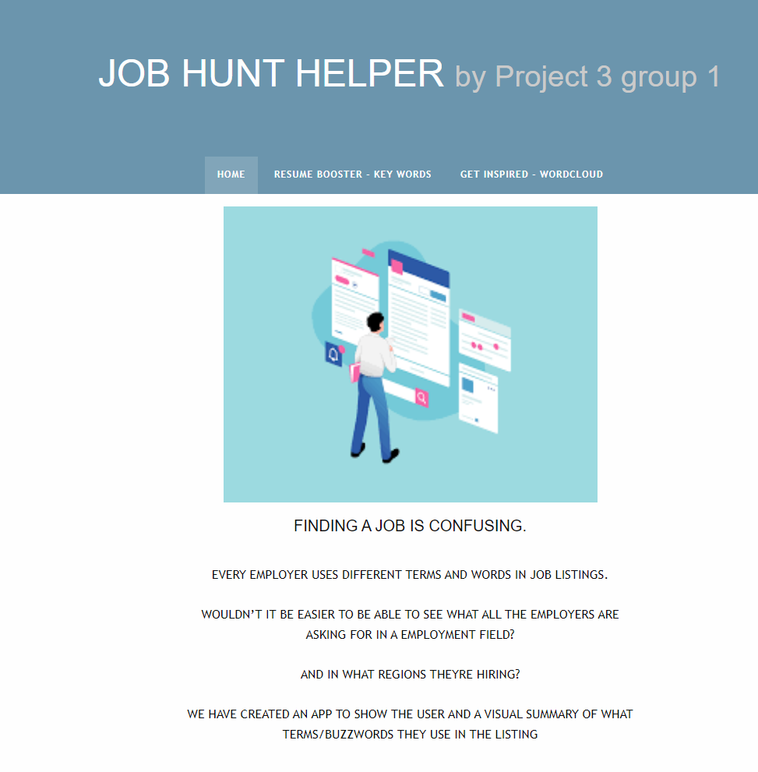
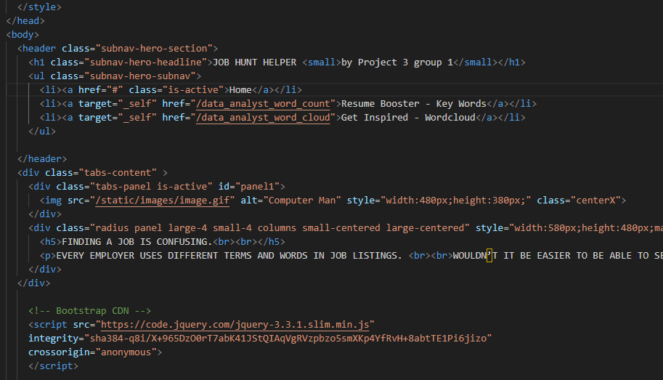
Show the app

Slide 18
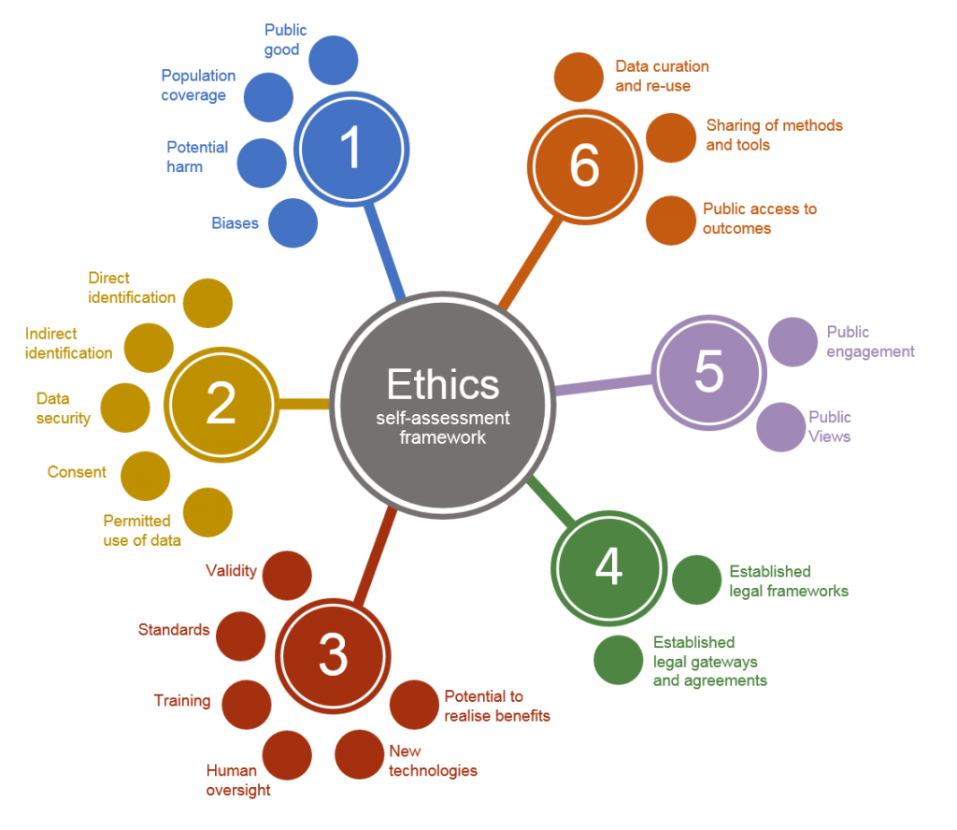
Data ethics
Seek: https://www.seek.com.au/jobs/in-All-Australia (permission: Confidential Information Communications between you and the SEEK Group should be regarded as confidential unless we expressly provide otherwise. You may only use such confidential information to perform your obligations or exercise your rights under these Terms. You must not disclose confidential information to any third party without our prior written consent. (https://talent.seek.com.au/partners/terms-of-use/))
Seek grants a limited, terminable, non-exclusive right to access and use websites and apps only for personal use and/or employment purposes.
Seek does not permit the use of data mining, robots, screen scraping, or similar automated data gathering, extraction or publication tools on websites and apps (including without limitation to establish, maintain, advance or reproduce the information contained on websites and apps on your website or in any other publication), except with prior written consent.

Slide 19
Future Enhancements
Advanced Analytics: Implementing more advanced analytics features, such as trend analysis and predictive modelling, could further enhance the tool’s capabilities and provide deeper insights into job market trends.
User Interface: Developing a user-friendly interface for the tool could make it more accessible to a broader audience, including those less familiar with programming and data analysis.
Integration with Job Boards: Connecting the tool with popular job boards and job search engines could automate data retrieval and improve the timeliness and relevance of job information.

Slide 20

Thank you

